Slide 1
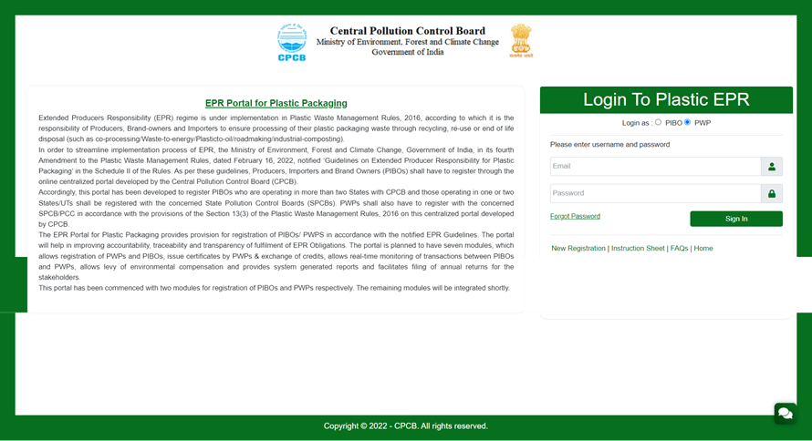
PWP – ACTIVE SELECTION FOR LOGIN
Login page for PWP with new signup details to be entered. In case you forget the password, please click on the link and follow the process to generate a new password. OTP authorization would be required so keep the registered mobile number handy to receive the SMS.

Slide 2
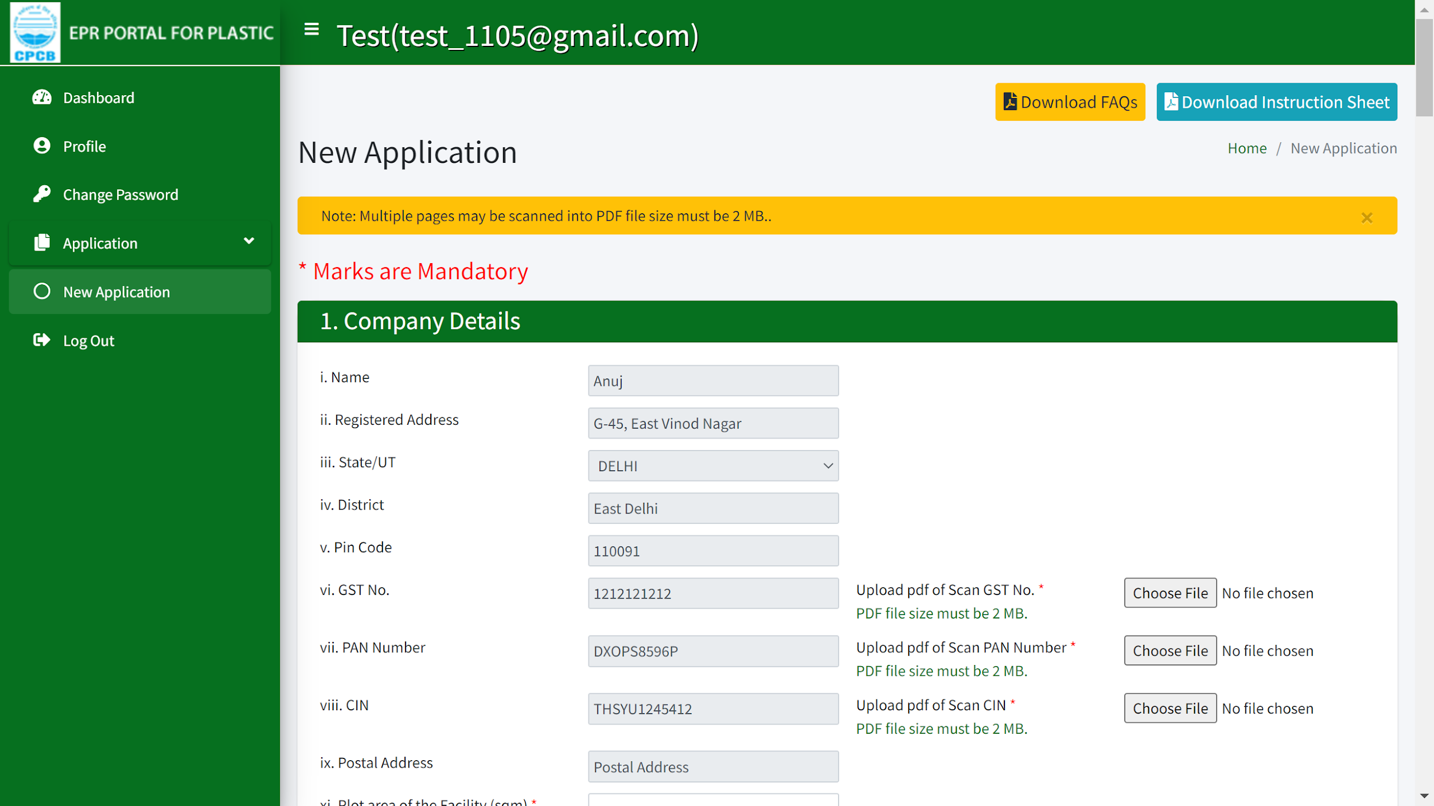
PWP APPLICATION
Company details are required to be filled in new application from the 'New Application' tab option. Documents required are GST, PAN and CIN.
All fields marked in red asterisk are mandatory. Please ensure that all data entered is true or else the application may be cancelled even at a later date.

Slide 3
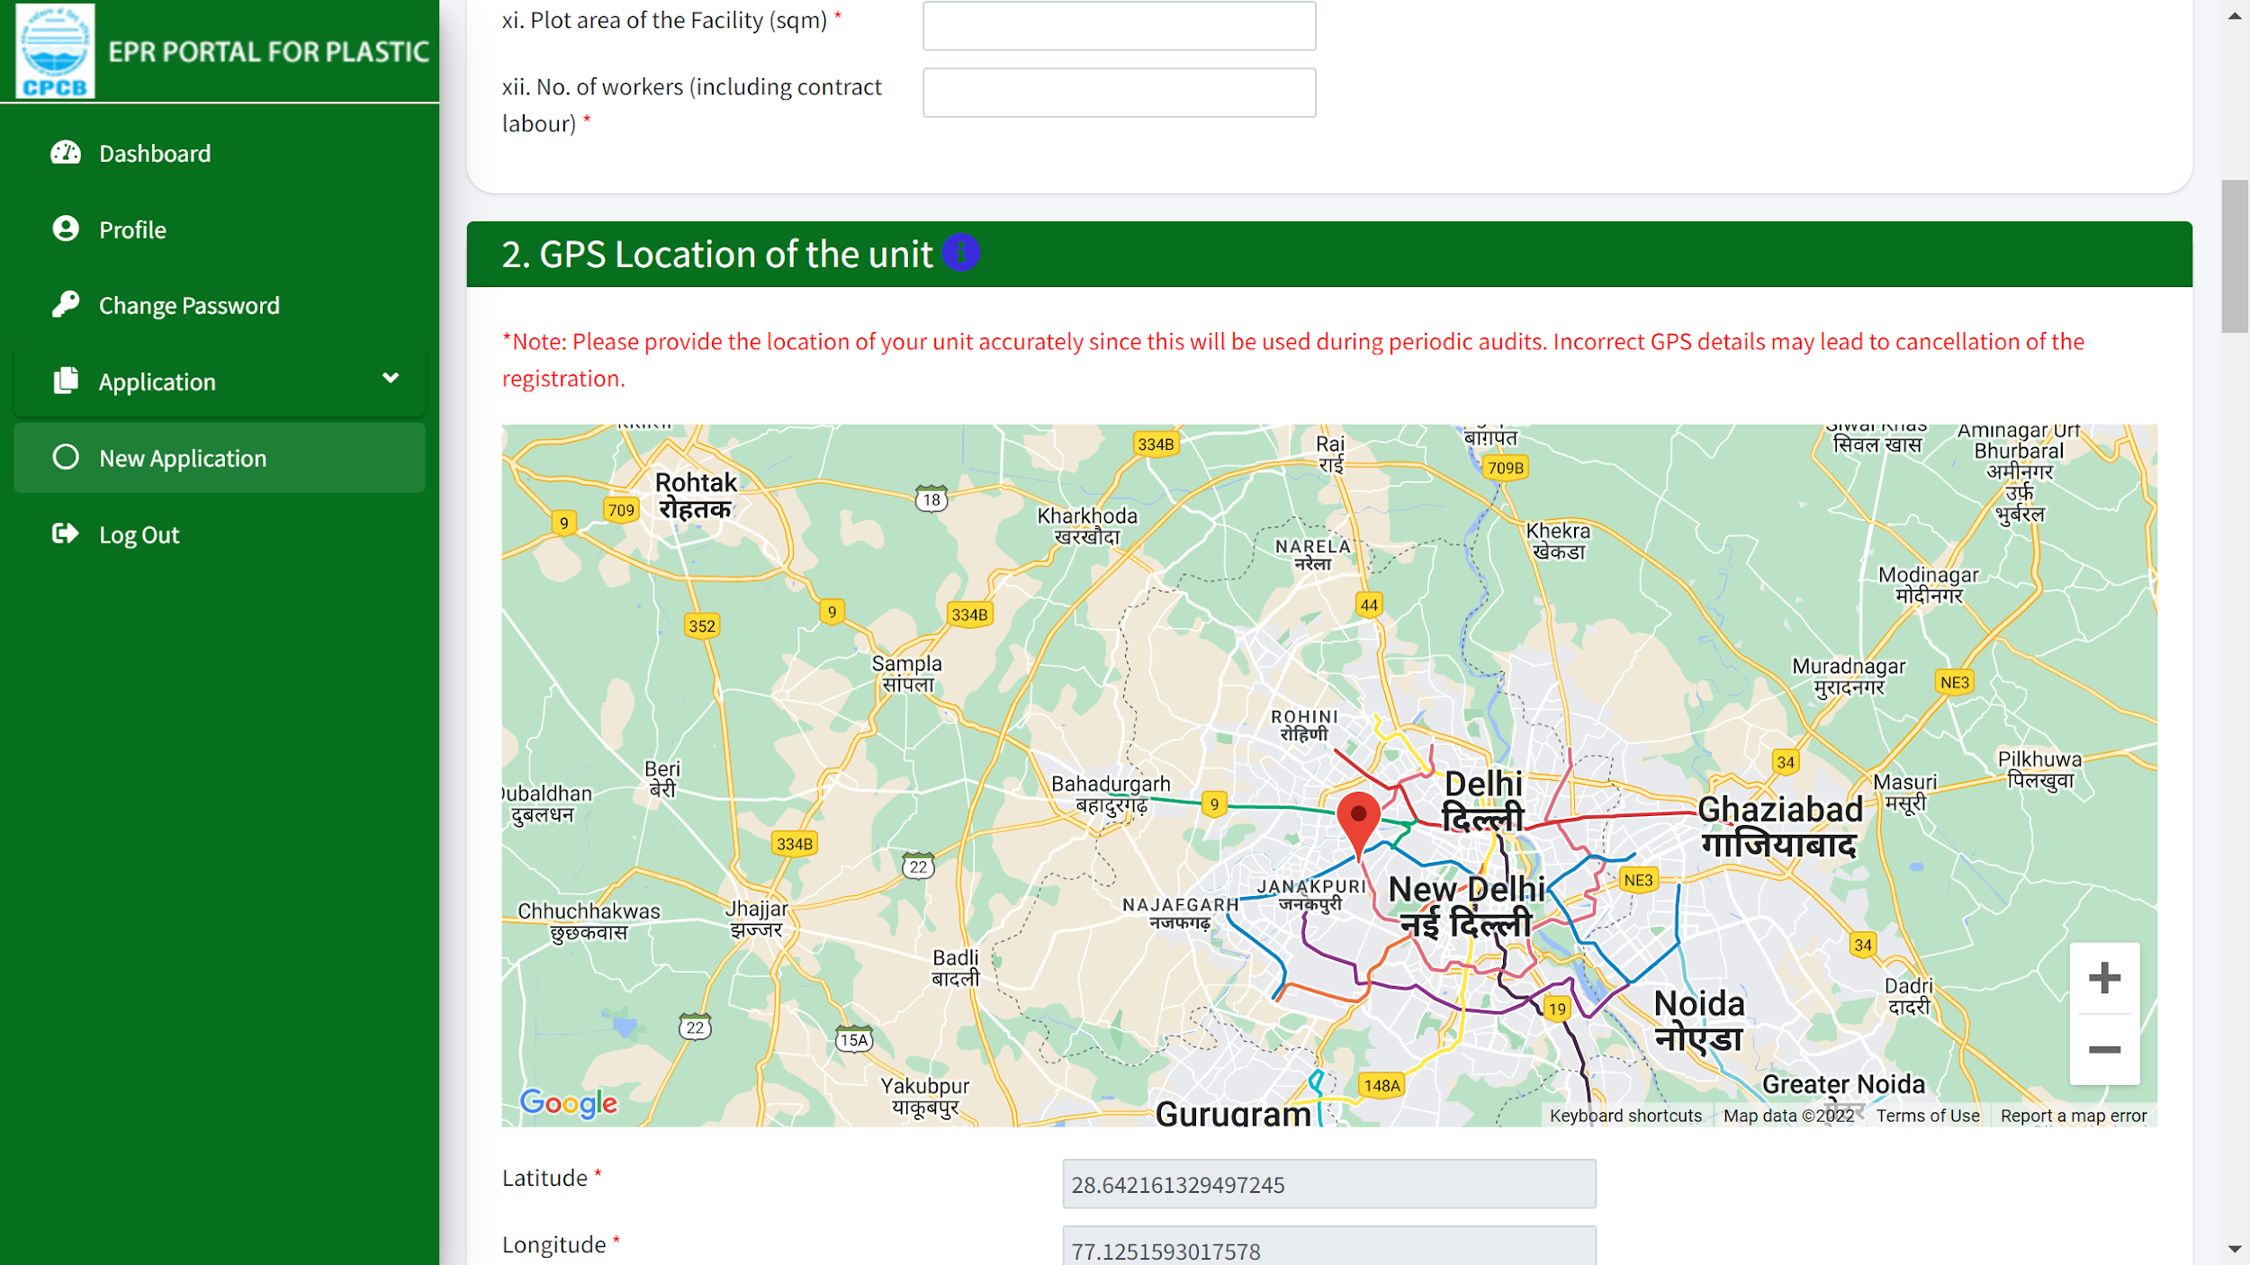
PWP APPLICATION
Precise location of the unit is required to be added using GPS selection in the map. You may move the locator on the map to get the exact location.
The Google map should be zoomed to the maximum possible resolution while marking the location.

Slide 4
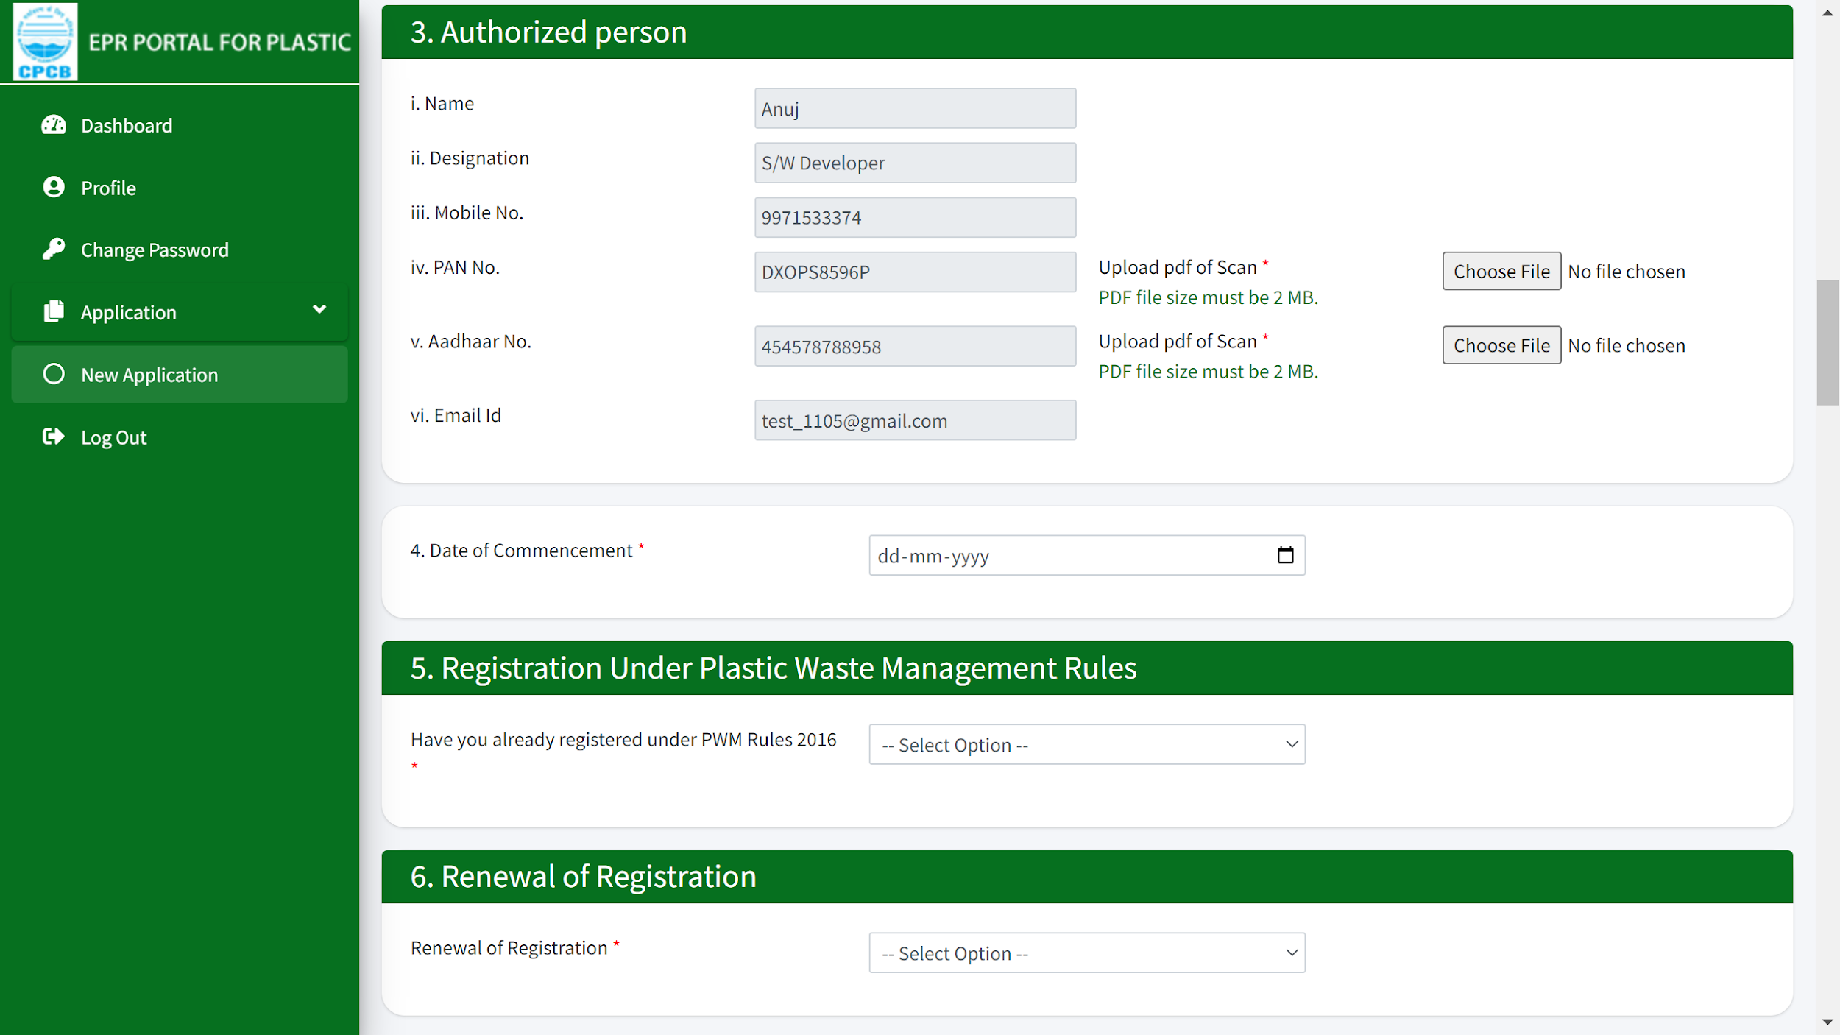
PWP APPLICATION
Authorized person details are required along with registration under PWM rules 2016 and the renewal of registration from 3-6.
PDF copy of the registration to be provided in case already registered with SPCBs in section 5.
PDF copy of old Registration to be provided in section 6.

Slide 5
CATEGORY OF PROCESSING IN APPLICATION FORM
7. Category of Processing ( 11 Processing Code)
R1: Recycling of CAT-: I PW to Pellet/Chips
R2 : Recycling of CAT-II PW to Pellets/Chips
R3 : Recycling of CAT-Ill PW to Pellets/Chips/fibers
R4 : Recycling of CAT-I PW to Products
R5 : Recycling of CAT-II PW to Products
R6 : Recycling of CAT-Ill PW to make Products
C1 Processing CAT-IV PW for industrial composting
E1 : End of life PW co-processing in cement plants
E2 : End of life PW co-processing in steel plants
E3: End of life PW processing in Waste to Energy plants
E4: End of life PW processing in Waste to Oil Units

Slide 6
PWP APPLICATION FORM
8.0 Process Flow Diagram(Same as Producers)
Note: Should be compatible with category of processing
9.0 Consent Details: Same as PIBOs
Additional : Details of Authorization details under HWM Rules to be provided
10. Geotagged Pictures & Video
Raw material Storage
Production Area
Product dispatch area
Video Link
Note:
Should match with Process code & PFD
GPS location of pictures should match with GPS location of plant

Slide 7
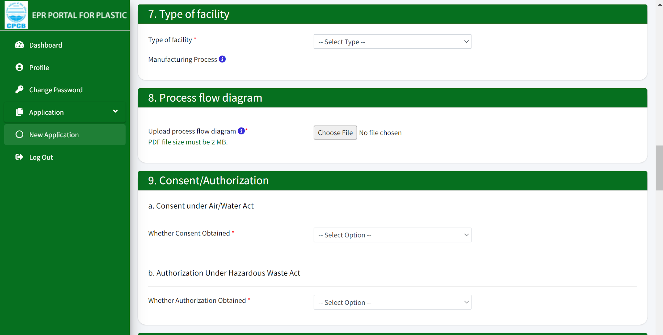
PWP APPLICATION
7-9: Type of facility, pdf file for process flow diagram, consents & authorization documents need to be submitted. Please note that the size of the files to be uploaded and the type are mentioned and have to be followed to complete the process.

Slide 8
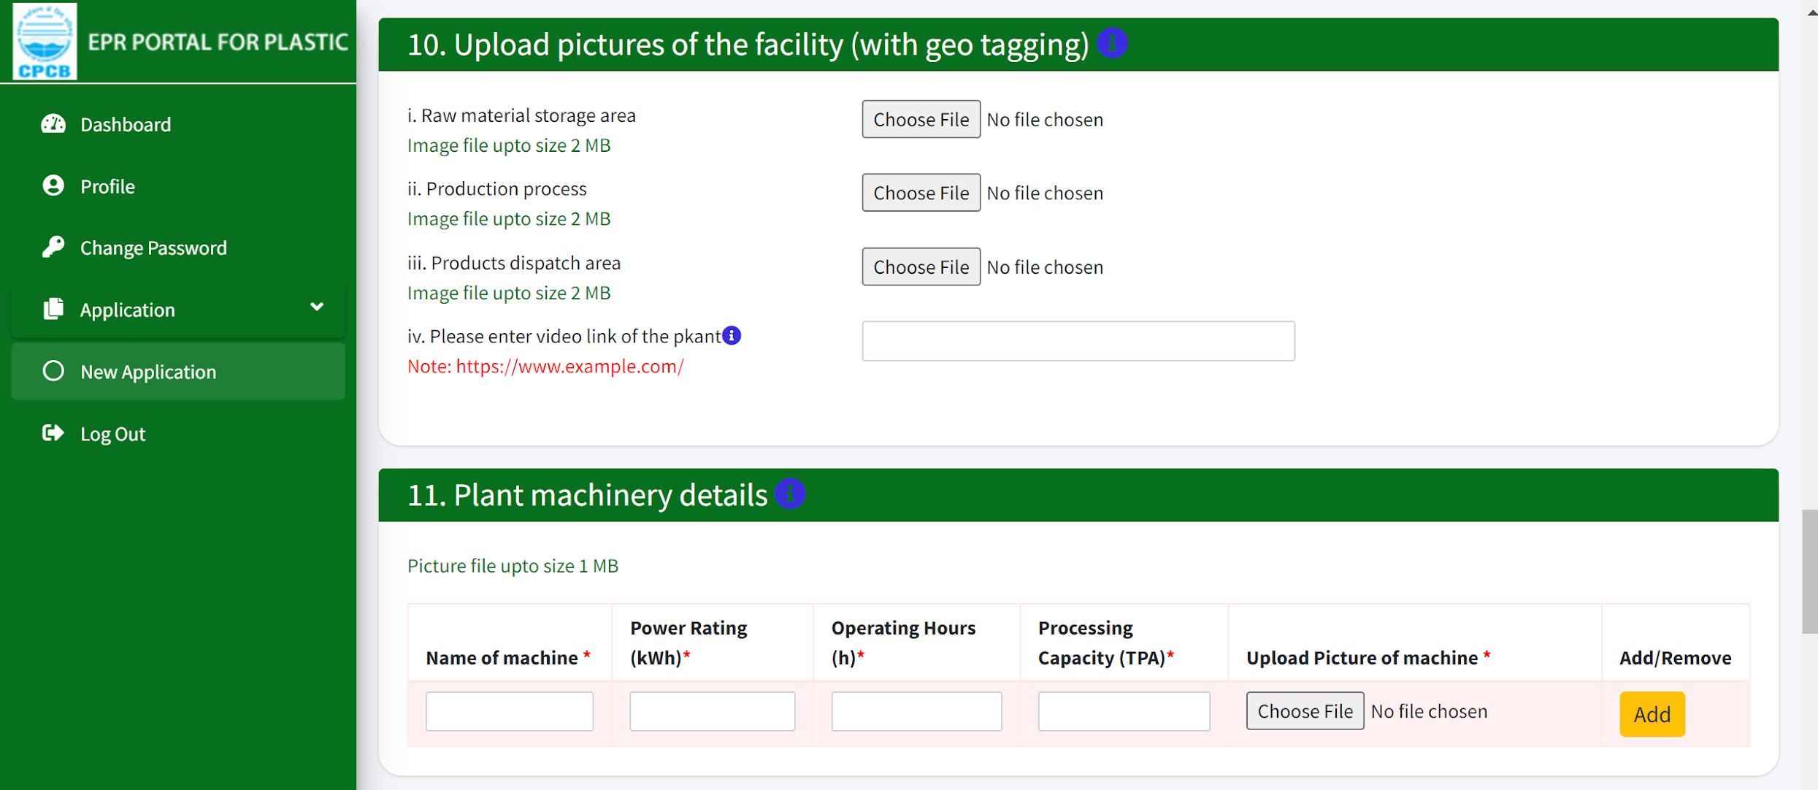
PWP APPLICATION
10 & 11: Pictures of the facility with geo-tagging are required to be uploaded process wise along with the plant video link. Plant machinery details are to be submitted with operational details.

Slide 9
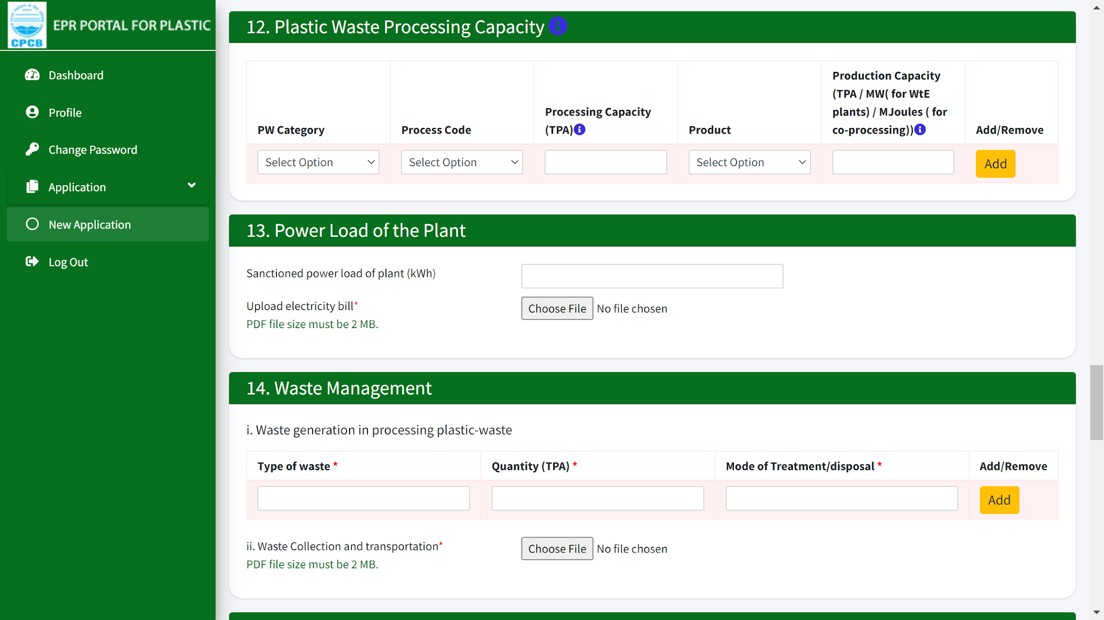
PWP APPLICATION
12-14: Plastic waste processing capacity and power load needs to be provided with uploading of documents. Waste management including mode of treatment needs to be entered in the fields of 14(I).

Slide 10
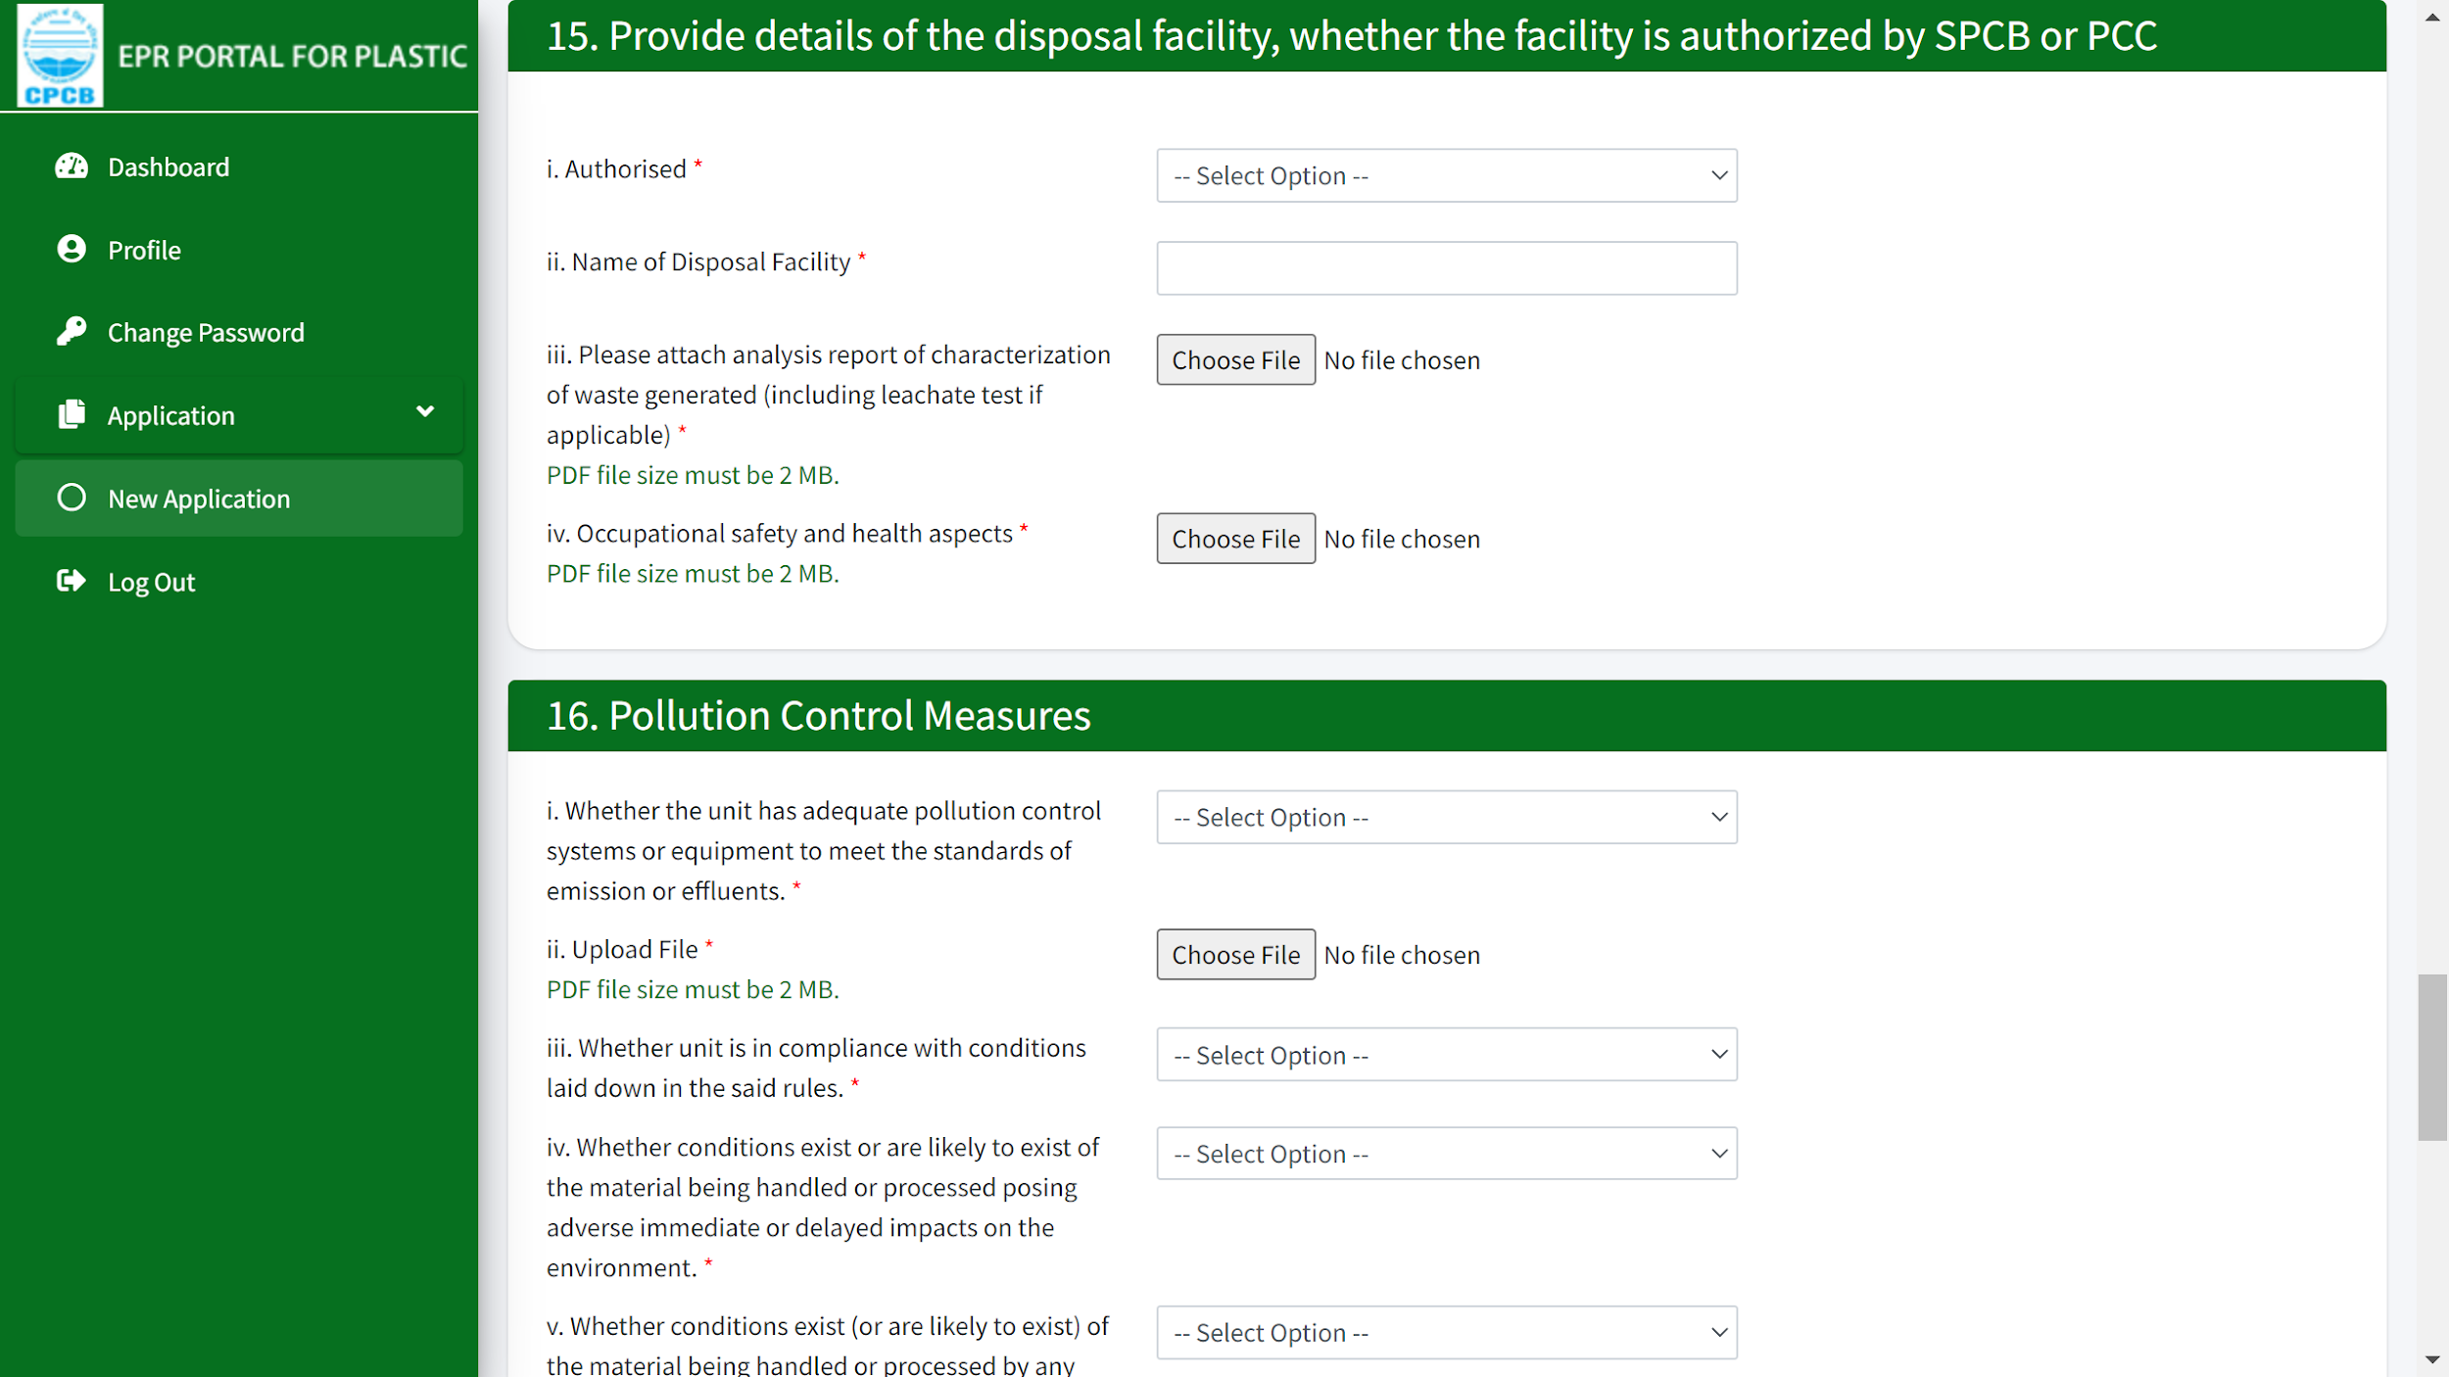
PWP APPLICATION
15 & 16: Details of facility and its authorization status is required to be submitted with waste characterization report. Pollution control measures with adequate systems meeting the standards need to be provided with document file.

Slide 11
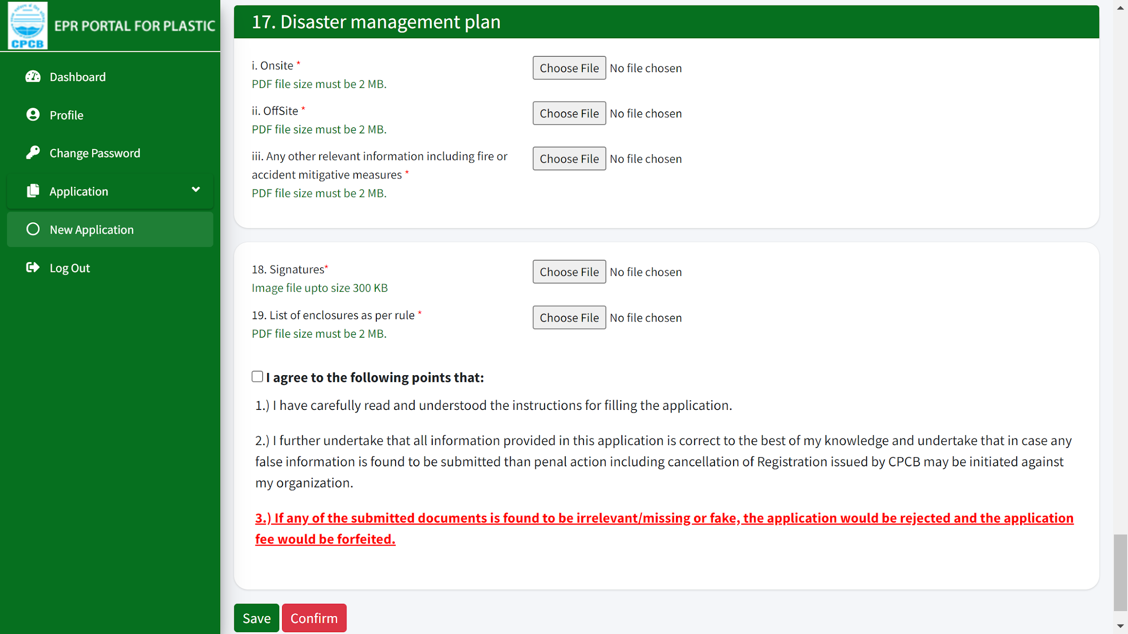
PWP APPLICATION
Disaster management plan needs to be submitted with documents to be uploaded for onsite and offsite status. Lastly, along with signature and agreement, form can be completed and saved.

Slide 12
APPLICATION FEES AND ANNUAL PROCESSING CHARGES
S. No | Plastic Waste Processing ( TPA) | Application Fees ( Rs)
1 | < 200 | 5000
2 | 200-2000 | 20000
3 | >2000 | 50000
Fees for renewal of Registration shall be same as same as Registration fee.
25% of Application fees is to be paid as Annual Processing Fees at the time of filing annual return

Slide 13
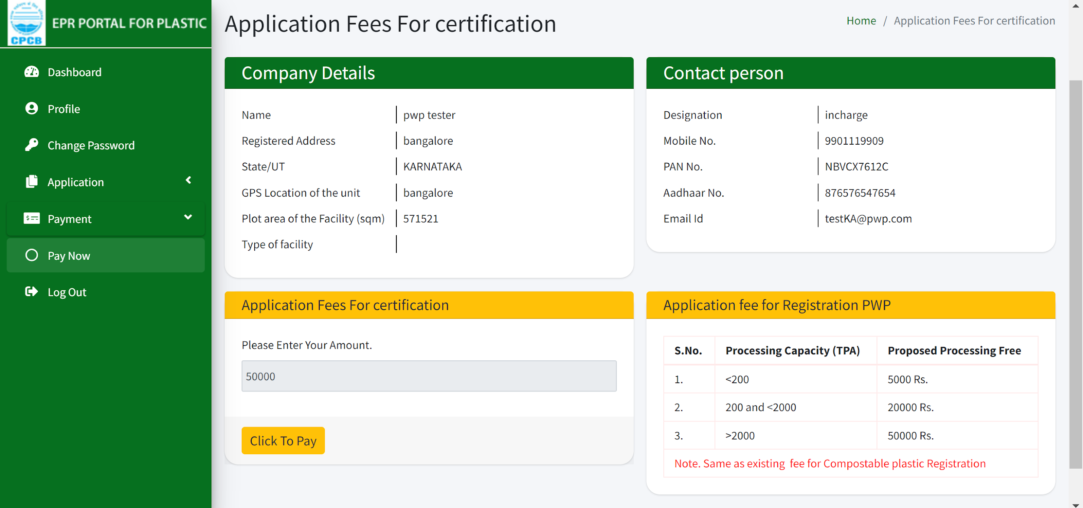
PWP PAYMENT DISPLAY PAGE
Enter the application fees amount for certification and click on ‘Click to Pay’ in order to complete the payment.
Notes:
FAQ Q13b covered here

Slide 14
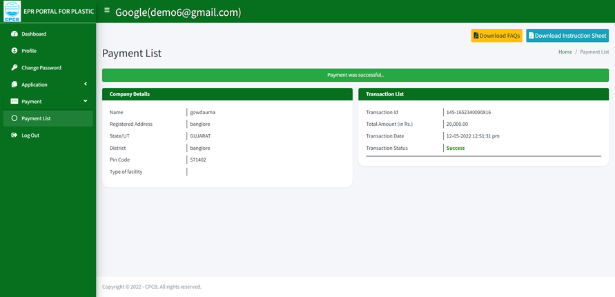
PWP - AFTER PAYMENT DISPLAY PAGE
Display page upon successful payment in the 'Payment List' tab.

Slide 15
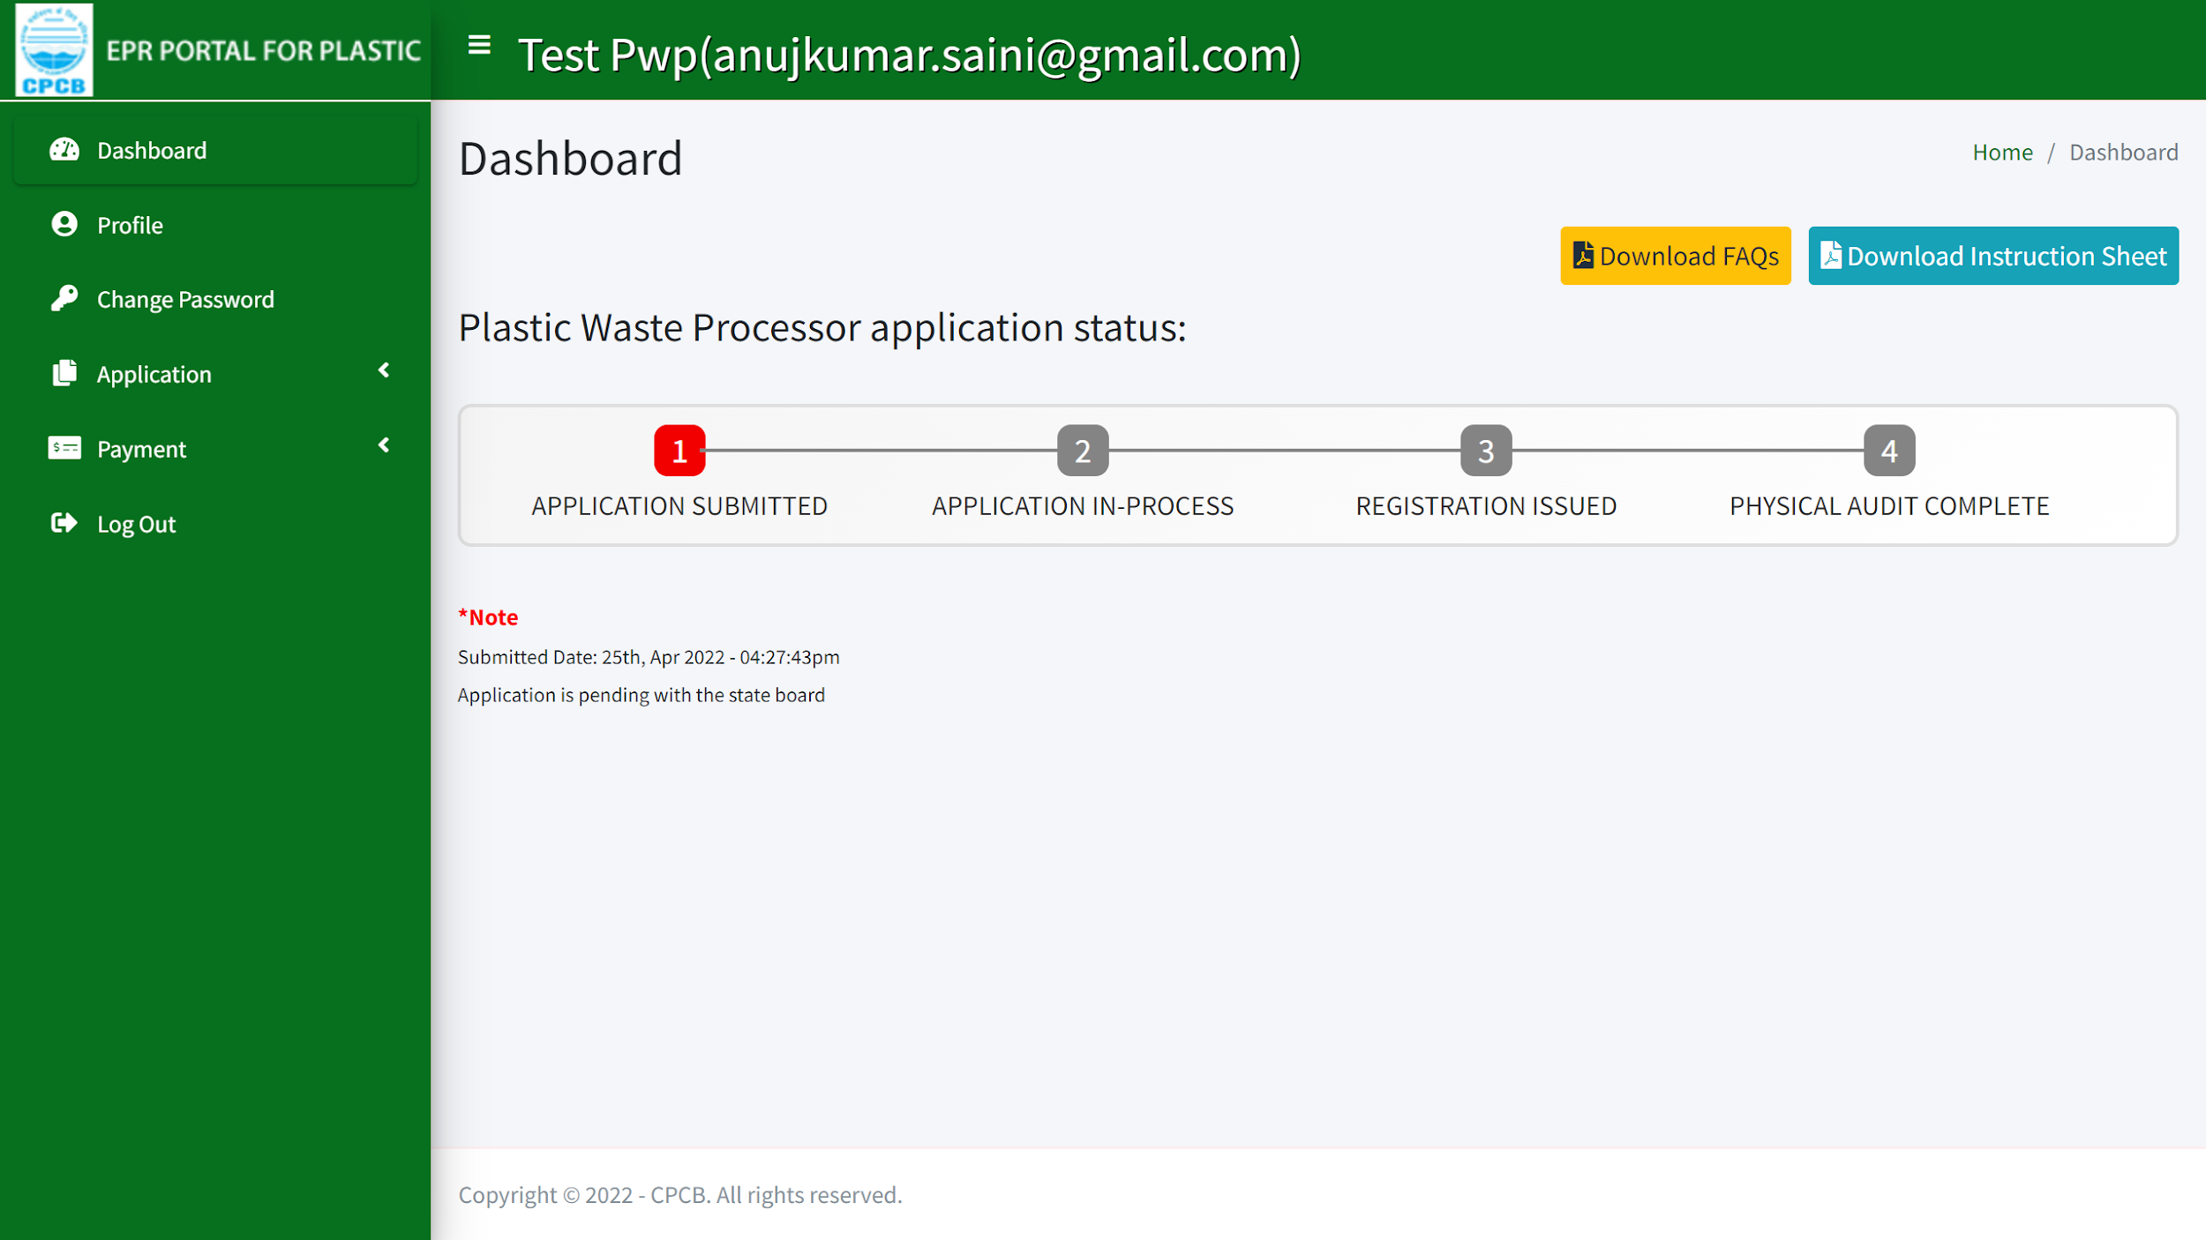
SUBMITTED APPLICATION
Status of submitted application on the dashboard is displayed. This can be checked till the registration has been approved by the SPCB.

Slide 16
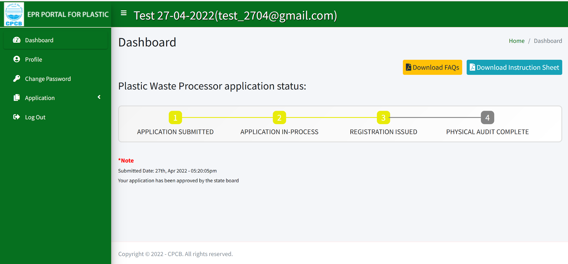
REGISTRATION ISSUED
Issuance of registration for PWP.

